Slide 1
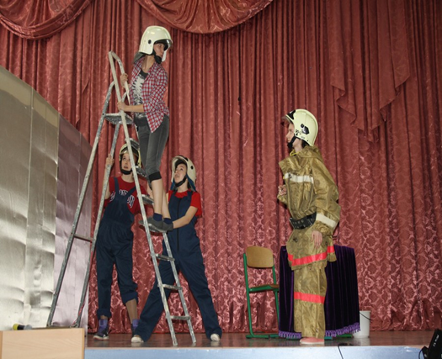
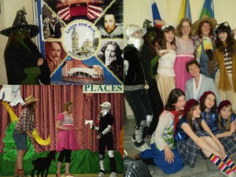
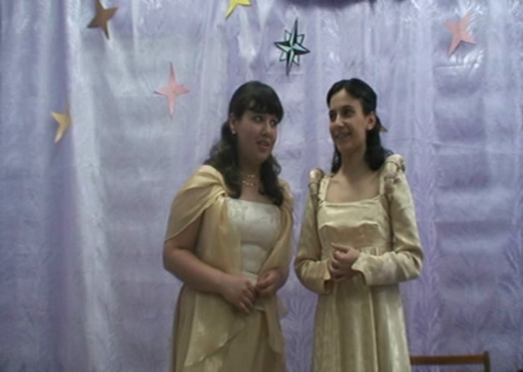
“LOVE the Life you Live! LIVE the Life you Love!”

Slide 2
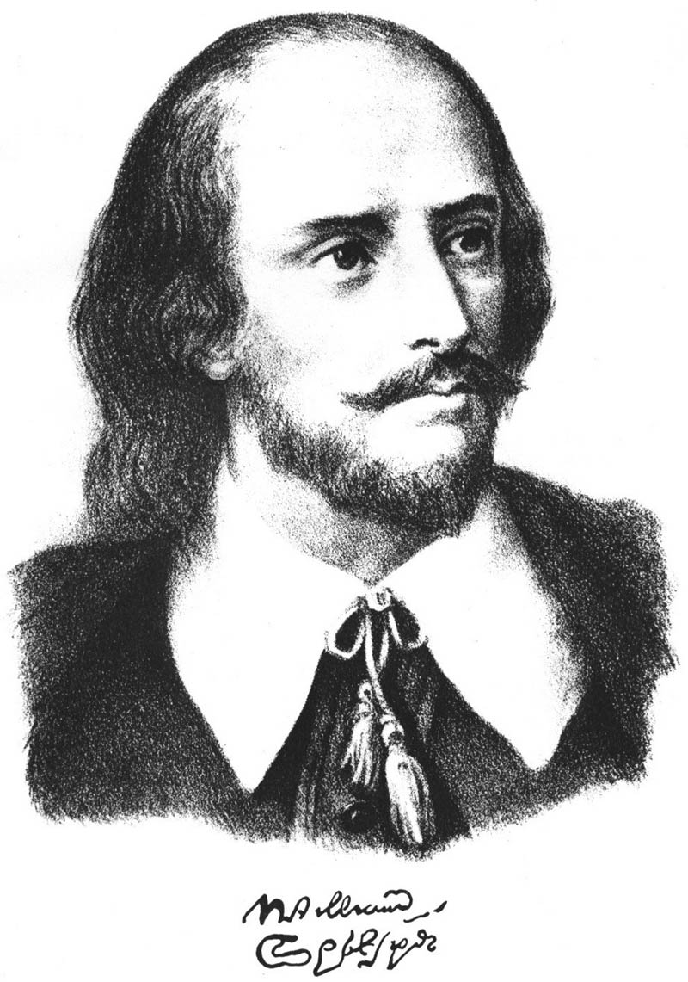
W.Shakespeare
“ALL THEWORLD’S
A STAGE…”
458 years since birth

Slide 3
“AS YOU LIKE IT”

Slide 11
