Slide 1
Module 8 “Across the curriculum. Social Sciences” Project Lesson

Slide 2
How’s it going?
I am doing fine, thank you! And you?
How are you?
No complaints, thank you!
Never felt better in my life!
Hello! How are you doing?

Slide 3
Let’s make up 3 groups:
MUST
HAVE TO
We ___ plant trees or flowers around our houses.
We ___ keep the neighborhood clean and tidy.
We ___ keep the pavement in front of our home clear of snow.
We ___ to follow our pets with a plastic bags to clean up after them.
We ___ to tell a local authority if we see someone doing graffiti.
We ___ to build nesting boxes for birds.
MUSTN’T
We ___ damage road signs.
We ___ drop rubbish all around the ground.
We ___ leave our dogs’ mess.

Slide 4
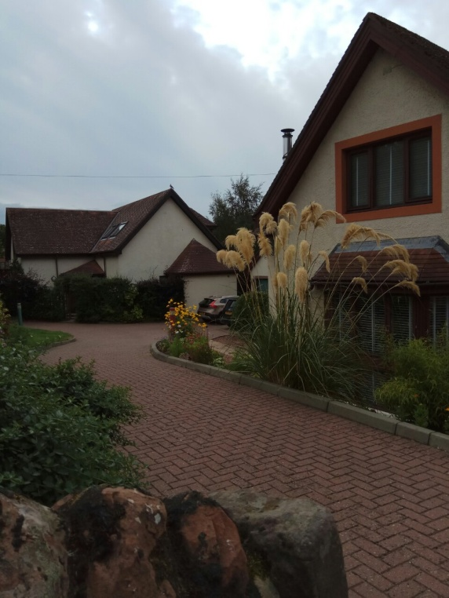
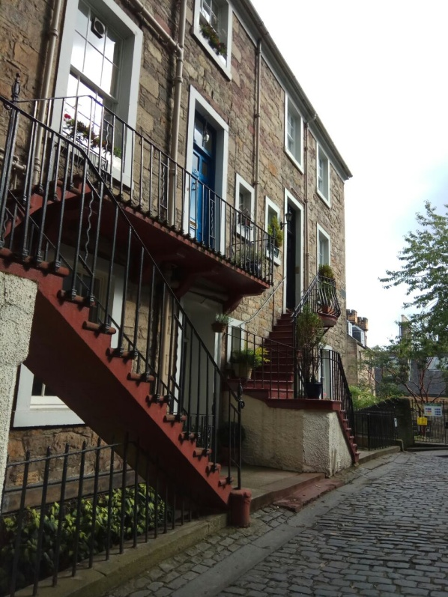
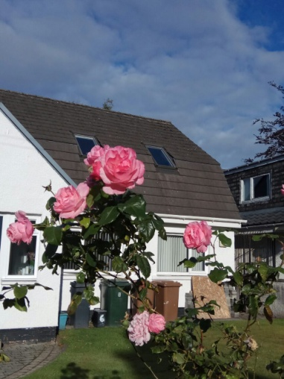
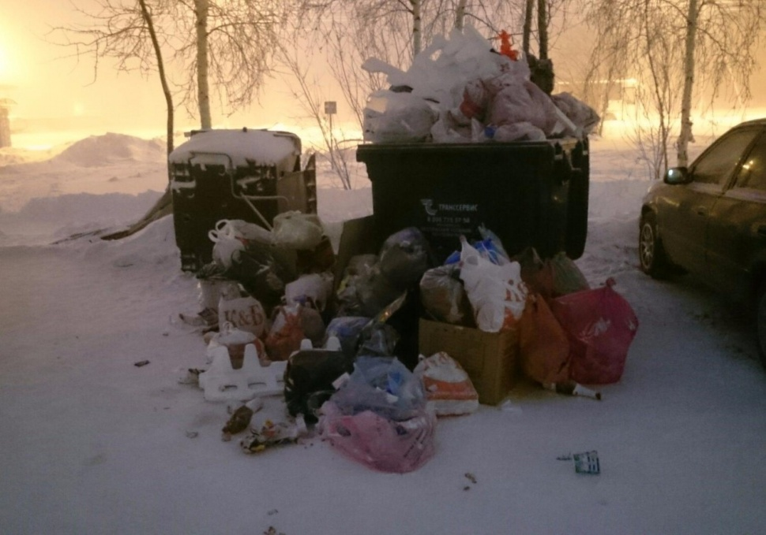
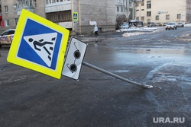
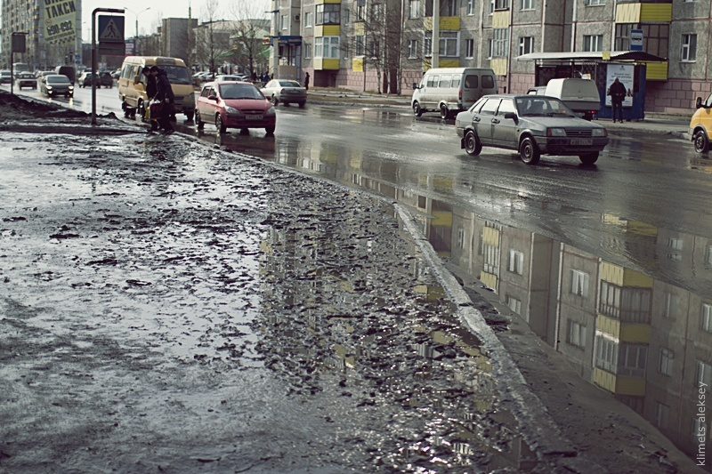
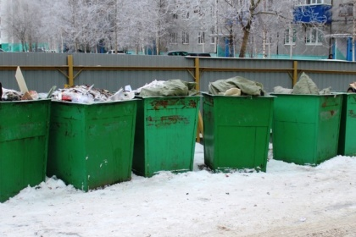
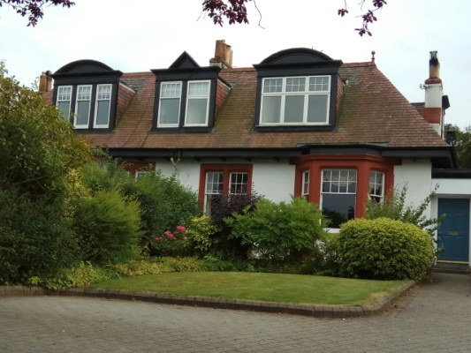
Look and compare the pictures of
Nizhnevartovsk, Russia
Eastbourne, The UK

Slide 5
Is your neighbourhood neat and tidy?
1. | Can you see graffiti on the buildings? | Yes/ No
2. | Are the streets and roads full of litter? | Yes/ No
3. | Are there parked cars on the pavements? | Yes/ No
4. | Do you usually find chewing gum on the benches in the parks? | Yes/ No
5. | Can you see any broken swings in the playground? | Yes/ No
6. | Are the rubbish bins full? | Yes/ No
7. | Are the road and street signs damaged? | Yes/ No
8. | Are the bus stops old and their benches broken? | Yes/ No
9. | Are the traffic lights out of order? | Yes/ No
10. | Does it smell in the area? | Yes/ No

Slide 6
Count your score
0-3 No Start looking after your neighbourhood! After all, it is your home!
4-5 No You are on the right track. With a bit more work, your neighbourhood is going to look much better!
6-7 No You have a very neat and tidy neighbourhood! Well done!

Slide 7
3 project questions
Why worry?
What can I do to make my neighborhood a better place to live?
Why isn’t our neighborhood clean and tidy?

Slide 8
How can we make the area cleaner?
Make an article for a local magazine or a newspaper
Make a podcast
Make a leaflet
or a poster

Slide 9
PROJECT PLAN
Study the text to make neighborhood rules.
Choose the necessary sentences.
Transform the sentences using modal verbs.
Correct your text according to the rubric.
Choose the role for the podcast.
Practice pronunciation.
Record the podcast.
Present the result.
Assess the work of other groups according to the criteria.
Assess your own group activities.

Slide 10
PODCAST INSTRUCTION
Study the text.
Find the necessary sentences.
Transform the sentences using the modal verbs (must, mustn’t, have to).
Choose the beginning and the end of the podcast.
Discuss the sentence order.
Choose the role for the podcast.
Practice your pronunciation; listen to each other, correct if it's necessary.
Start recording.
Check the result.

Slide 11
РУБРИКА ОЦЕНИВАНИЯ ПОДКАСТА
 |  | 3 балла | 2 балла | 1 балл
Решение коммуникативной задачи |  | -Задание выполнено полностью. -Составлены 2 предложения с must, 2 предложения с mustn’t, 2 предложения с have to. -Текст состоит из 8-10 предложений. -Соблюден стиль и формы вежливости. | -Задание выполнено не полностью. -Не раскрыт 1 аспект. -Текст состоит из 6-8 предложений. -Соблюден стиль и формы вежливости. | -Задание выполнено не полностью. -Не раскрыты 2 и более аспектов. -Текст состоит из 4-6 предложений. -Соблюден стиль и формы вежливости.
Организация подкаста |  | Текст логичен. Структурирован: есть фразы приветствия, основная часть и фразы прощания. | Текст логичен. Есть нарушения в структуре, отсутствует какая либо часть текста подкаста. | Текст нелогичен, есть нарушения в структуре текста подкаста.
Языковое оформление | Грамматика | Глаголы долженствования использованы без ошибок. | Допущены 1-2 ошибки. | Допущены 2 и более ошибки.
 | Произношение | Произношение слов без ошибок | Допущены 1-2 ошибки. | Допущены 2 и более ошибки.
12 – 11 баллов «5» 10 – 9 баллов «4» 8 – 6 баллов «3»

Slide 12
ЛИСТ ОЦЕНИВАНИЯ ПОДКАСТА
 |  | Группа 1 | Группа 2 | Группа 3
Решение коммуникативной задачи
Организация подкаста
Языковое оформление | Грамматика
 | Произношение
ВСЕГО

Slide 13
REFLECTION
Choose the sticker which summarizes the lesson best
It was very difficult
Boring,
I didn’t
like it
It was Stressful
Amazing,
I felt happy!
Fascinating,
I like teamwork
I liked to make the podcast
I enjoyed the lesson
Didn’t know what to do

