Slide 1
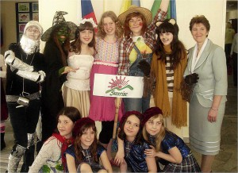
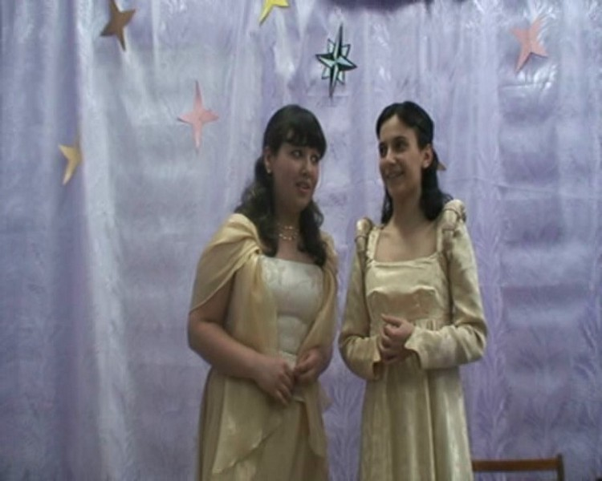
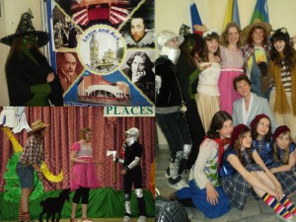
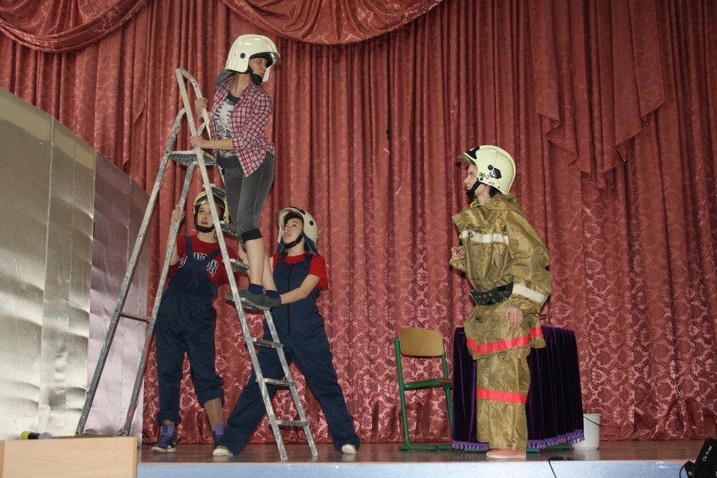
SunRise
Theatre Studio
School 43

Slide 2
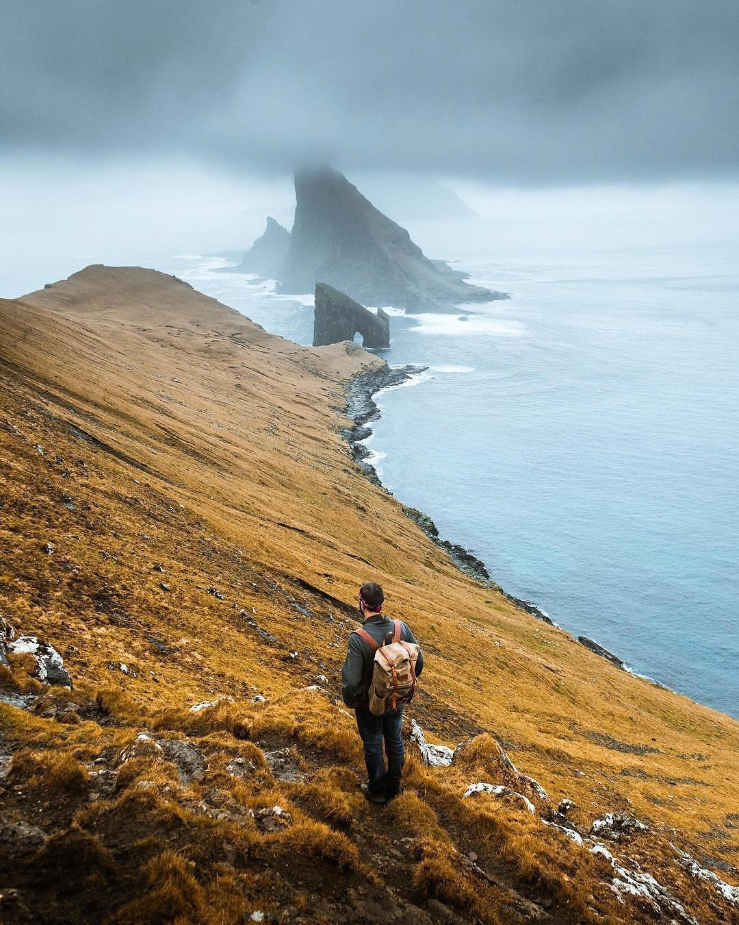
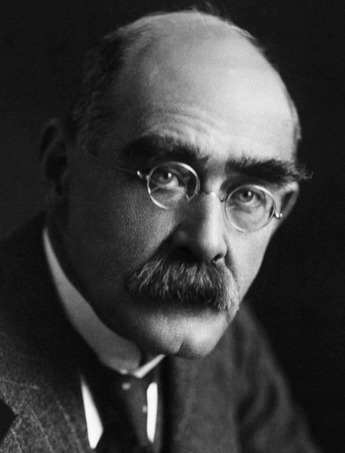
If
Rudyard Kipling

Slide 3
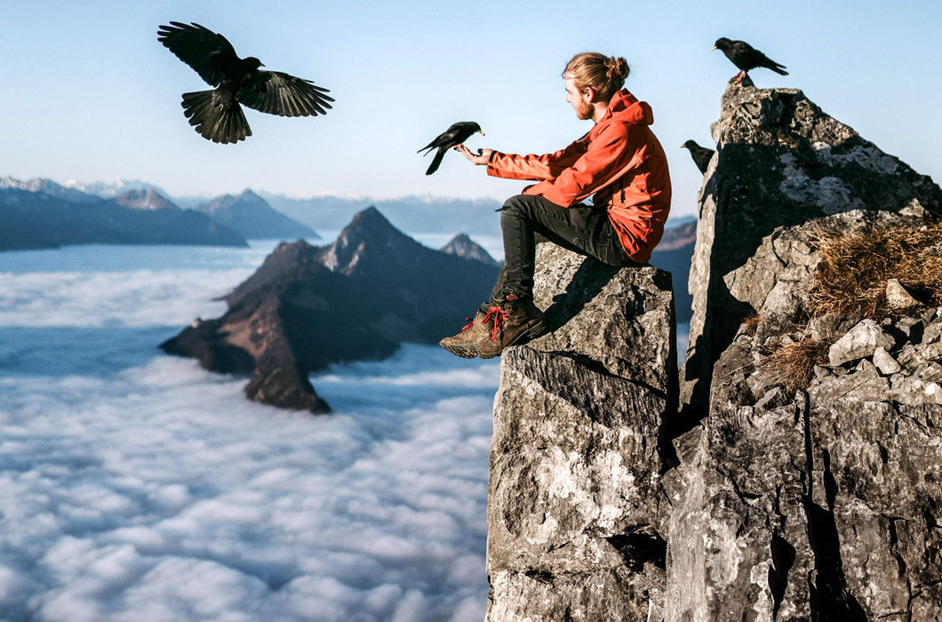
If
Rudyard Kipling
Если
Самуил Маршак

Slide 4
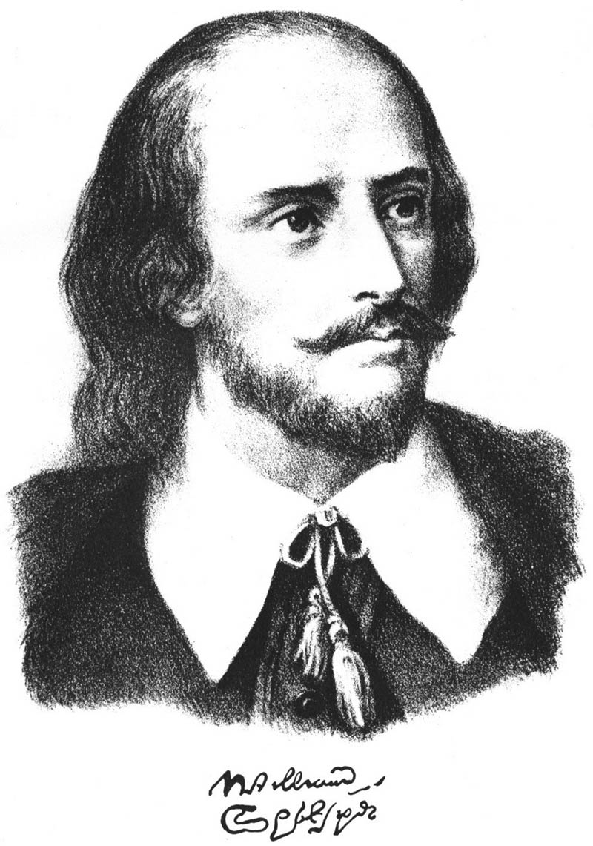
W. Shakespeare
“ALL THEWORLD’S
A STAGE…”
455 years since birth

Slide 5
“AS YOU LIKE IT”

Slide 13
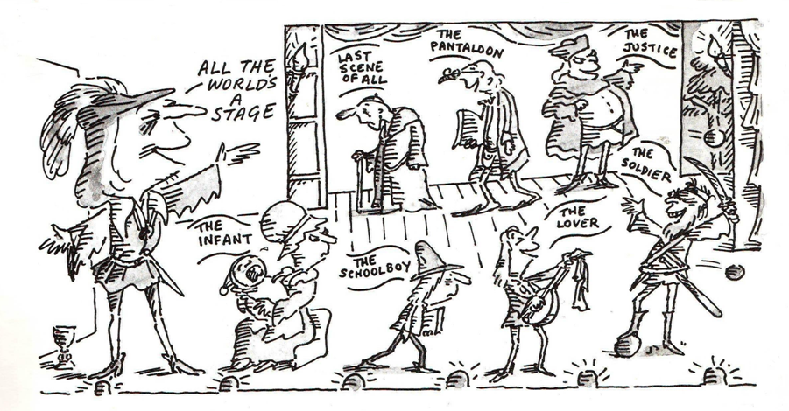

Slide 14
SunRise Theatre Studio
Oscar Wilde

Slide 15
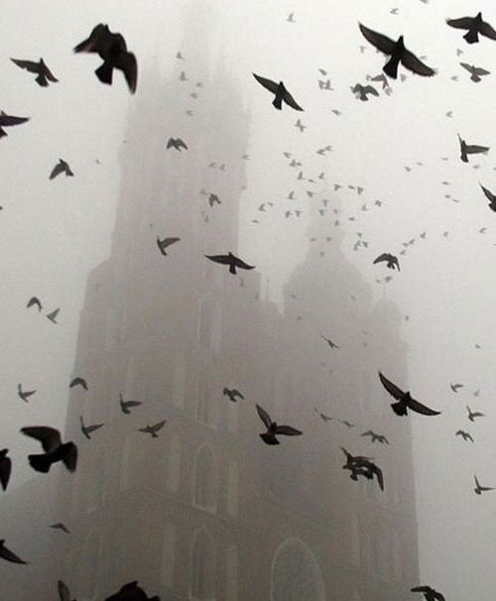

Slide 16
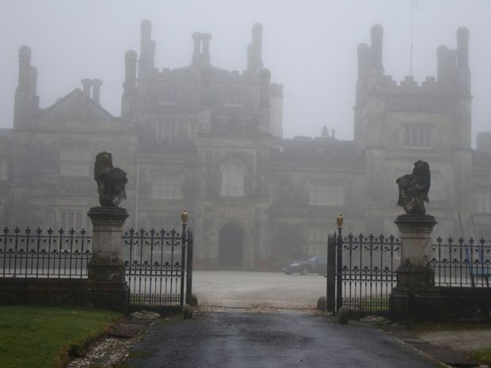

Slide 17
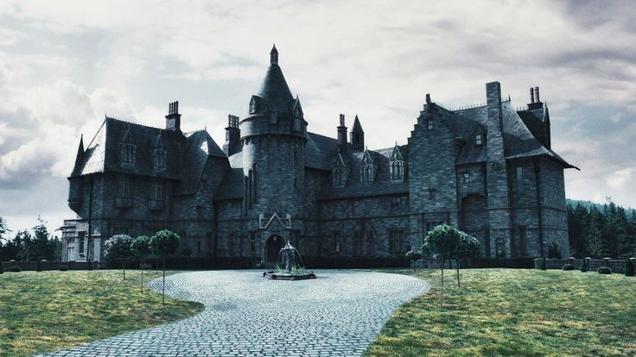

Slide 18
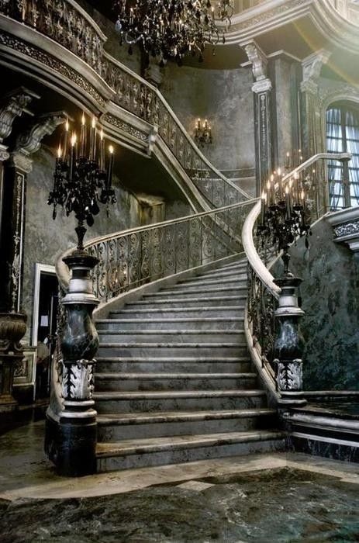

Slide 19
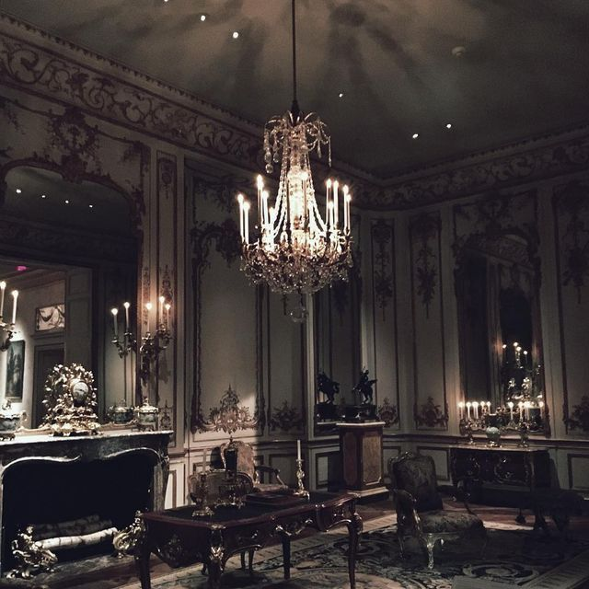

Slide 20
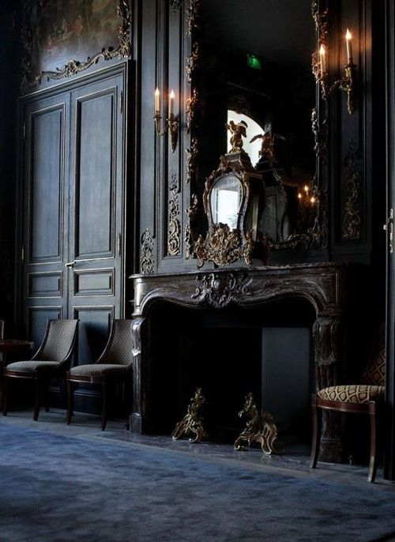

Slide 23
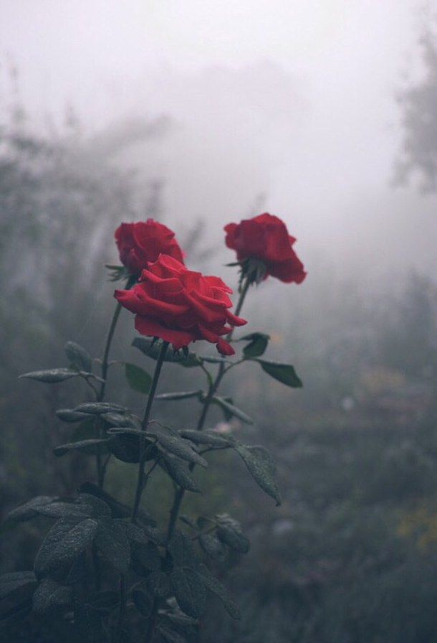

Slide 25
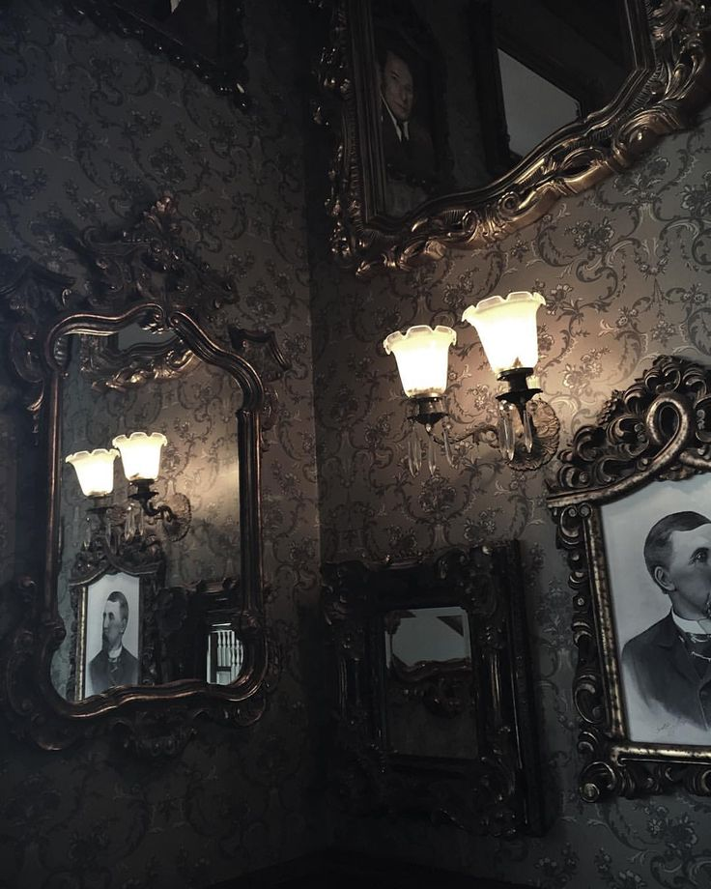
WHEN A dark- haired girl CAN WIN
A PRAYER FROM OUT THE LIPS OF SIN,
WHEN THE BARREN ALMOND BEARS,
AND A LITTLE CHILD GIVES AWAY ITS TEARS,
THEN SHALL ALL THE HOUSE BE STILL
AND PEACE COMES TO CANTERVILLE.

Slide 26
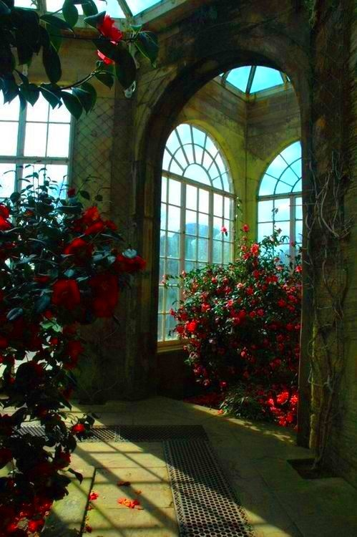
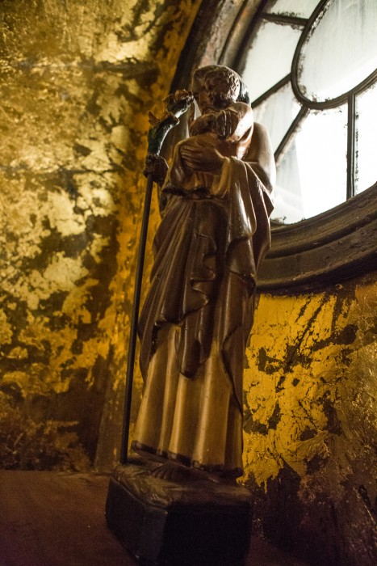

Slide 27
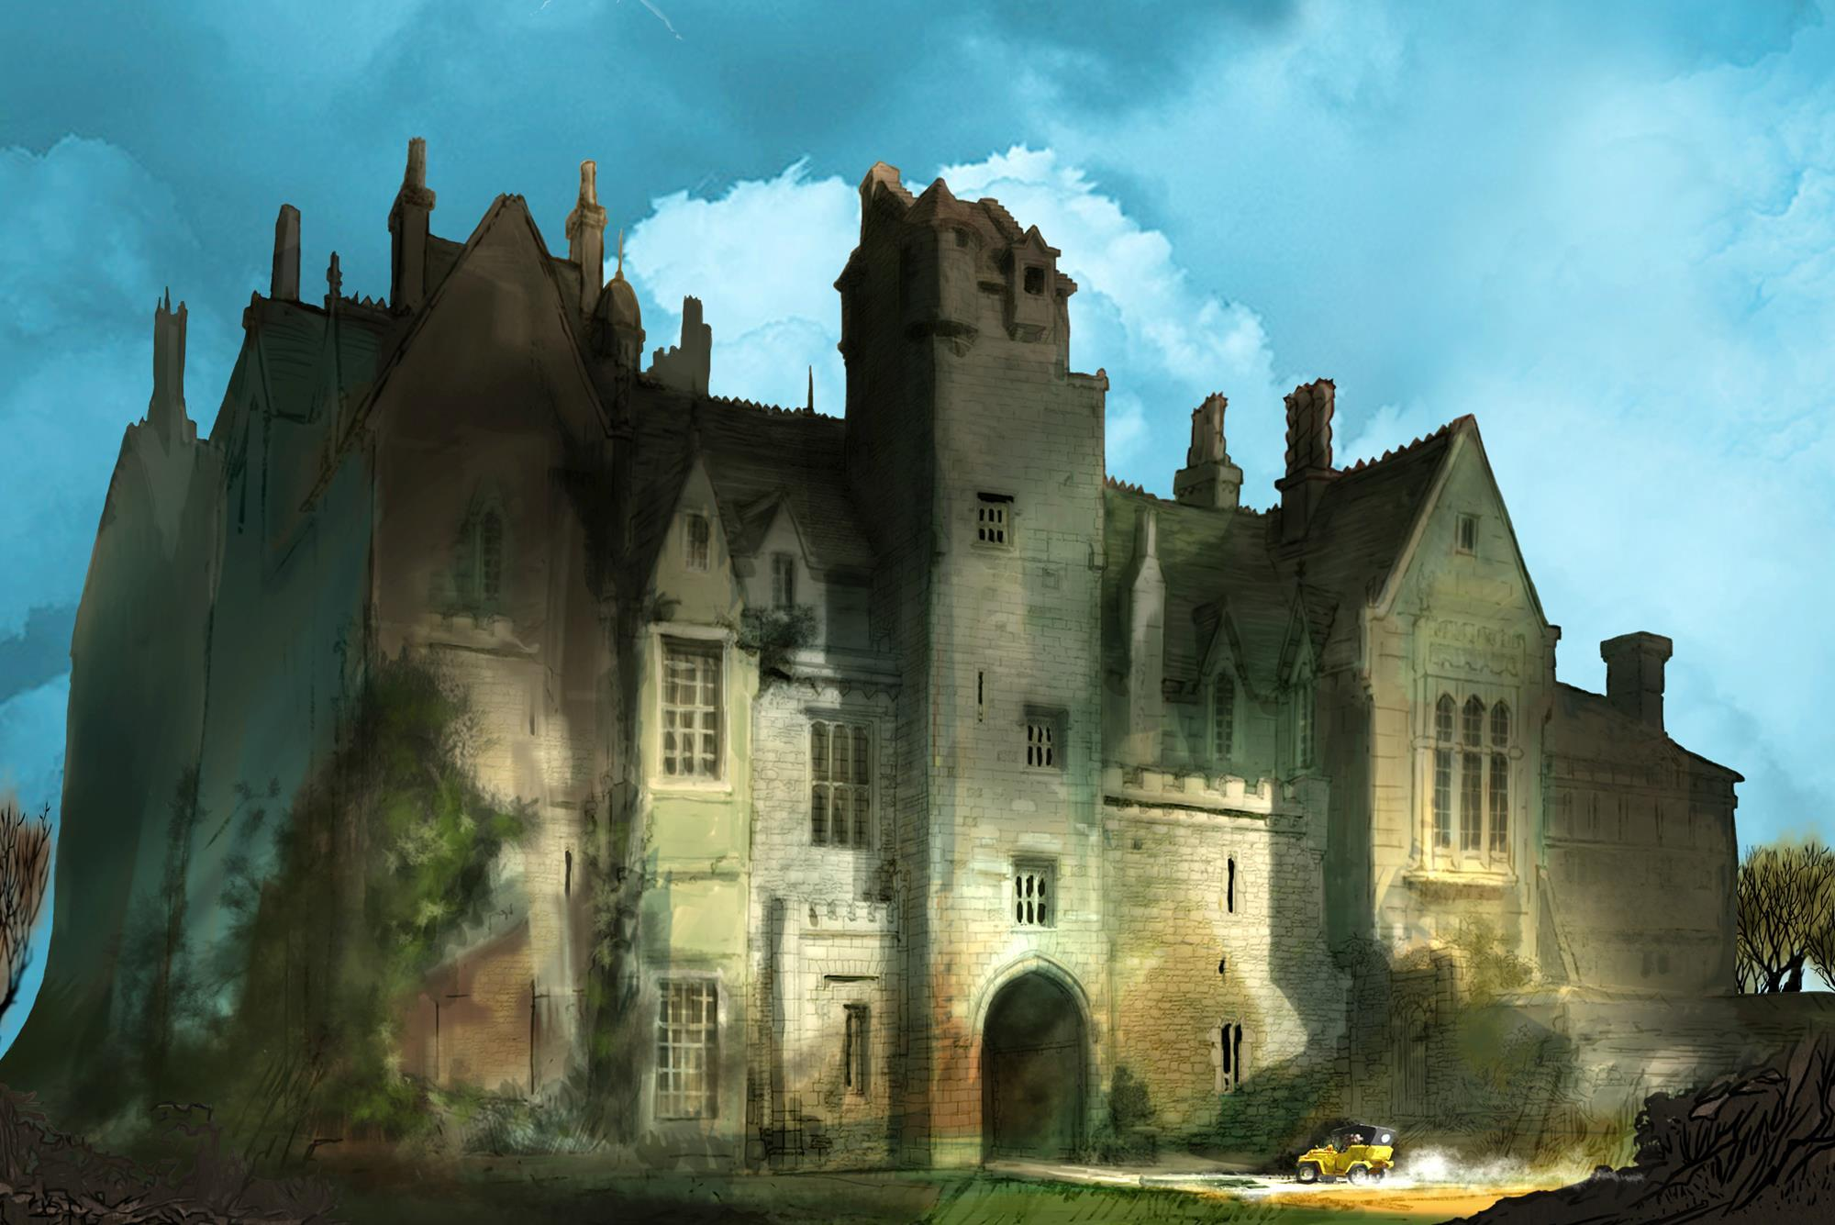
SunRise Theatre Studio
The song
“Seven rings”

Slide 28
SunRise
Theatre Studio
School 43

