Slide 1
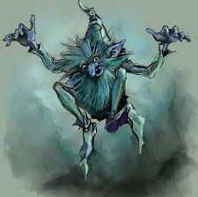
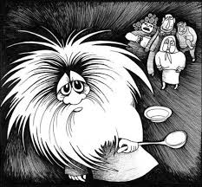
English and Russian Mythology
Prepared by Veronika Lobkova
Nizhnevartovsk State University
Supervised by Nelli Kalashnik

Slide 2
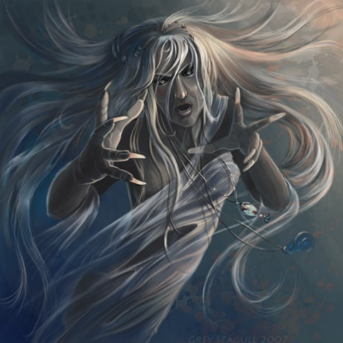
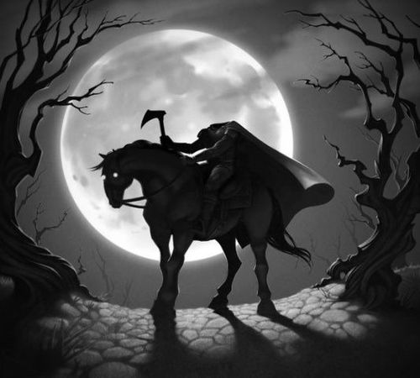
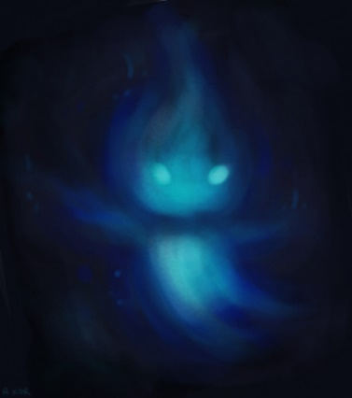
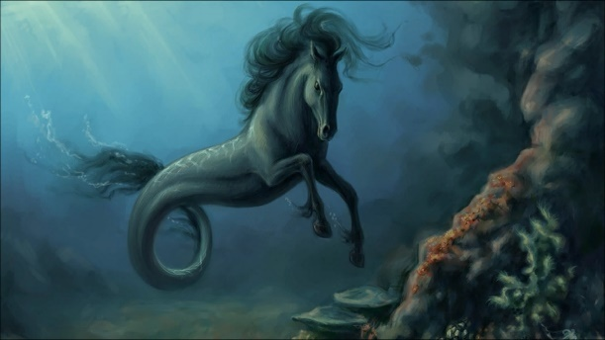
a)Knucker Of Lyminster
b) Banshee
c) Dullahan
d) Will-o’-the-Wisps
e) Kelpie
1) the headless horseman
2) The spirit of a forest
3) The sea monster
4) The female ghost
5) The Water dragon
1- c
2- d
3-e
4- b
5-a

Slide 3
Knucker Of Lyminster task1. Fill in the gaps
Bottomless, was terrorizing, deliver, was known, took up , had eaten
Lyminster has a dragon legend of which three different versions exist. The dragon 1__________as the Knucker and inhabited a supposedly 2________ pool known as the Knucker Hole and is situated just to the north of Lyminster.
In the first version, the dragon 3___________the area and 4__________all the women in the area, leaving only the King of Sussex’s daughter. The King offered his daughter’s hand in marriage to anyone who could 5______ her from the dragon’s jaws. A wandering knight 6________ the challenge and slew the beast.
was known
bottomless
was terrorizing
had eaten
deliver
took up

Slide 4
Task2. Fill in the gaps with the right form of the verb
eat, die(2), transport, feed, wipe, kill, need, to be (2), bake, get
Others say it 1_____ a local lad named Jim Puttock who 2_____ the dragon an indigestible pudding, then 3_____ it while it 4_____ indisposed with a bout of bellyache! He 5______ some of the dragon’s blood on his hand and, after 6_____ his mouth after a celebratory pint of beer, Puttock also 7_______.
In the third variation, Jim 8_______ a poisoned pie so huge that it 9________ a horse and cart to 10________ it to the Knucker hole. The dragon 11________ the pie, the cart, and the horse, and subsequently 12________. Knucker is believed to derive from nikyr, Old Norse for water monster.
was
fed
killed
was
got
wiping
died
backed
needed
transport
ate
died

Slide 5
Task3. Match the words with the synonyms
words
Correct answers
synonyms
a) indigestible
b) indisposed
c) bellyache
d) subsequently
A-3
B-1
C-4
D-2
1) unhealthy, sick
2) finely, afterwards;
3) unripe, toxic, uneatable;
4) abdominal pain

Slide 6
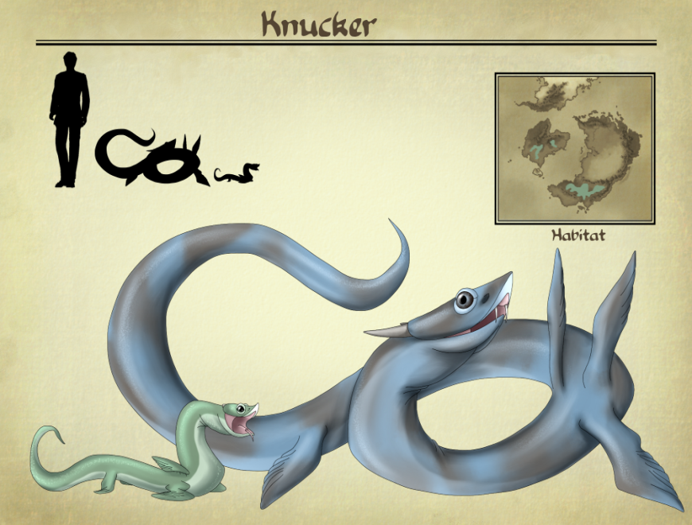
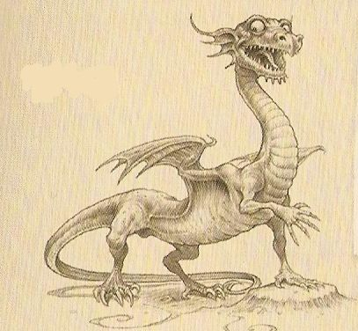

Slide 7
Will-o’-the-Wisps Task4. put the text in order.
4)In Britain and Ireland, Will-o’-the-Wisps were spirits of the dead who used the lights to lure travelers into treacherous marshes.
1) Their demeanors range from simply mischievous to malevolent, and they took pleasure in leading people astray and into dangerous situations.
2)Some see Will-o’-the-Wisps as death omens, particularly when they are seen in cemeteries.
3)The spirits could not enter either heaven or hell, and spent their days wandering the earth.
4)In Britain and Ireland, Will-o’-the-Wisps were spirits of the dead who used the lights to lure travelers into treacherous marshes.
Look through the words in the blue colour and write them down
3)The spirits could not enter either heaven or hell, and spent their days wandering the earth.
1)Their demeanors range from simply mischievous to malevolent, and they took pleasure in leading people astray and into dangerous situations.
2)Some see Will-o’-the-Wisps as death omens, particularly when they are seen in cemeteries.

Slide 8
Find out the meanings
a)lure into
b)treacherous
c)marshes
d)astray
e)malevolent
f)mischievous
g)demeanors
Correct answers
1)naughty, troublesome
2) off the path or right direction
3)behavior, manner 4) involve, seduce;
5)unstable, unreliable, dangerous 6)hateful, sinister
7)moor, swamp
A-4
B-5
C-7
D-2
E-6
F-1
G-3

Slide 9
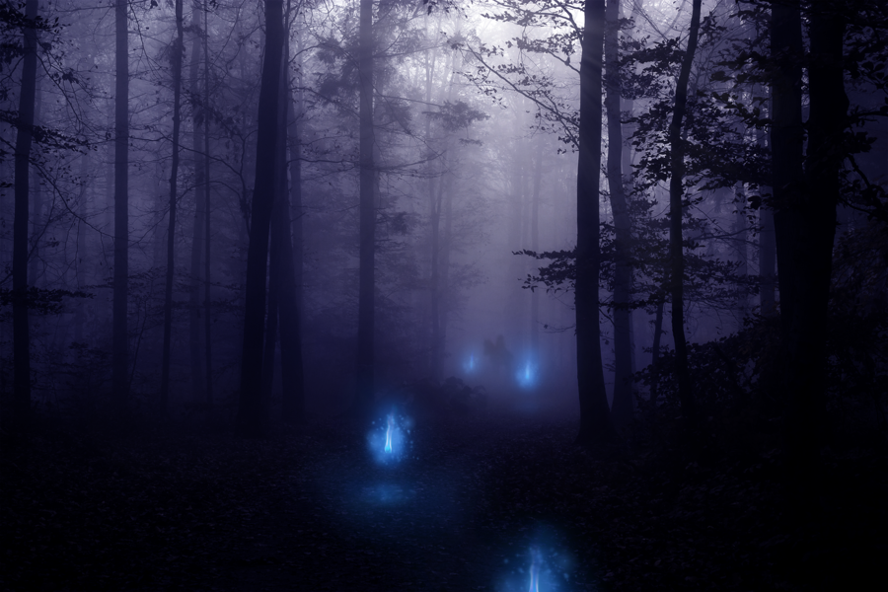

Slide 10
Dullahan Task5. Fill in the gaps with the right form of the verb.
Another legendary monster is the Dullahan, a name that can 1__(translate) to “dark man.” Often 2___(portray) in contemporary fantasy fiction and video games, this foreteller of death is the headless horseman. The Dullahan 3____(ride) headless a black horse with flaming eyes, 4____(carry) his head under one arm. When he 5___(stop) riding, a human 6___(die). Some versions of this legend 7___(say) that the Dullahan 8__(throw) buckets of blood at people he 9__(pass), while others say he simply 10__(call out) the name of the mortal that soon 11__(die). As with most evil forces, the Dullahan 12___(have) a weakness – gold.
The creature 13___(scare) of the substance, so any lonely traveler this Halloween night would be wise to have some on him in case they have a run-in with this headless horror!
1)be translated,2)portrayed,3)rides,4)carring,5)stops,6)dies,7)say,8)throws,9)passws,10)calls out,11)will die,12)has,13)is scared.

Slide 11
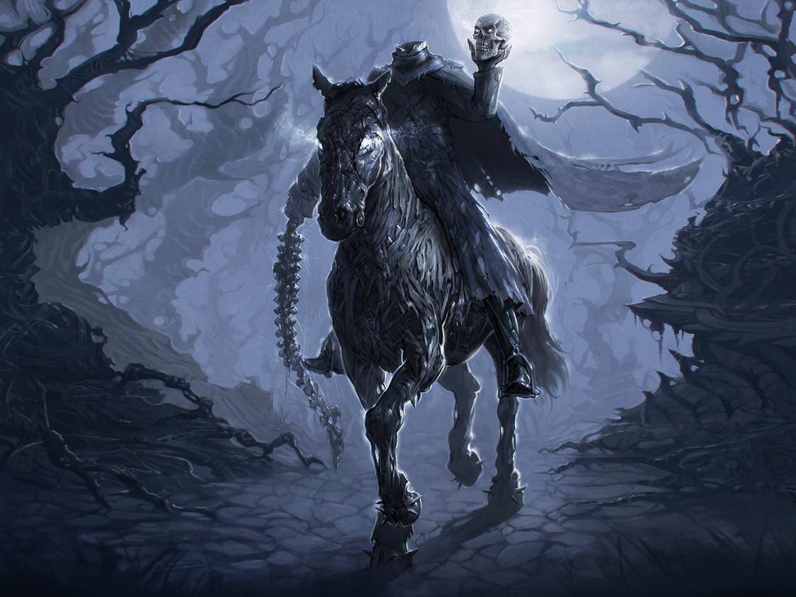
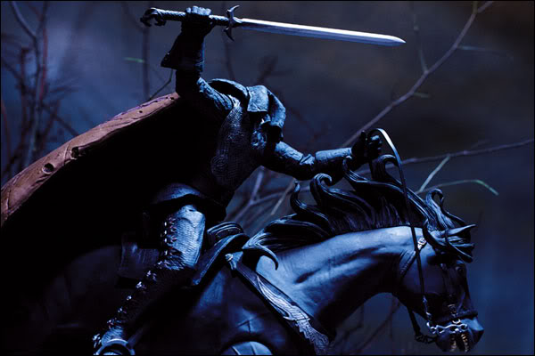

Slide 12
Banshee Task6. Fill in the gaps with the right word.
Spirit, legend, dies, several, recognizable, ugly, foretells, black cart, three, terrifying, beautiful
One of the most 1_________ Celtic creatures, the Banshee is a female 2_____ whose wail, if heard outside of a house, 3_______ the death of one of its inhabitants.
4______ versions of the Banshee 5______ say the feared ghost rode alongside the Dullahan in a 6________ drawn by six black horses. The pair is said to whip the horses with a human spinal cord. But most legends say the Banshee was 7_______ enough on her own.
Descriptions of her appearance vary, from an 8_______ old witch to a 9_______ young woman, but all agree that the creature’s blood curdling wail will be heard 10______ times before someone 11_____.
recognizable
spirit
foretells
Several
legend
black cart
terrifying
ugly
beautiful
three
dies

Slide 13
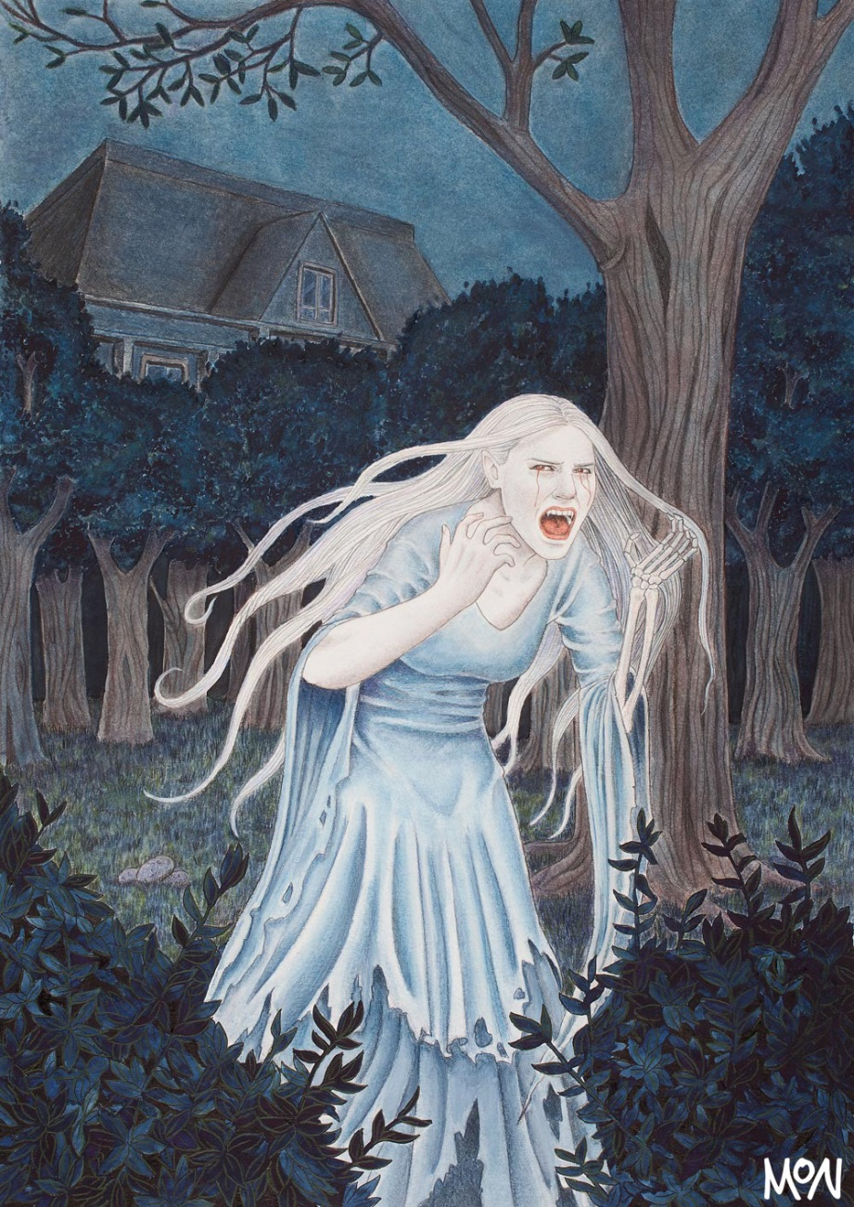
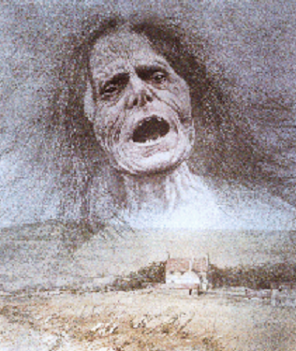

Slide 14
Kelpie Task 7. Fill in the gaps with the prepositions given.
On(5), with(2), around, out, into(3), in(2)
The Kelpie is a monster right 1____ of Celtic myth. The creature can take 2____ multiple shapes, but usually it appears 3____ the form of a horse.
The kelpie galloped 4______ Ireland, looking like a lost pony, attempting to trick women and children 5_____ riding 6__ it. But the strange thing about this pony is that its mane would always be dripping 7____ water. If a woman hopped 8____, the monster would then run 9____ the water, drowning its victim, and then would take her to its lair to eat her. The Irish demon would sometimes transform 10____ a handsome man to lure women to its trap, but a telltale sign that it was a kelpie if that “man” had kelp 11____ its hair.
Ladies, take note – meet a guy with seaweed 12____ his head 13____ a Halloween night, don’t go home 14_______ him!
out
on
in
around
into
on
with
on
into
into
in
on
on
with

Slide 15
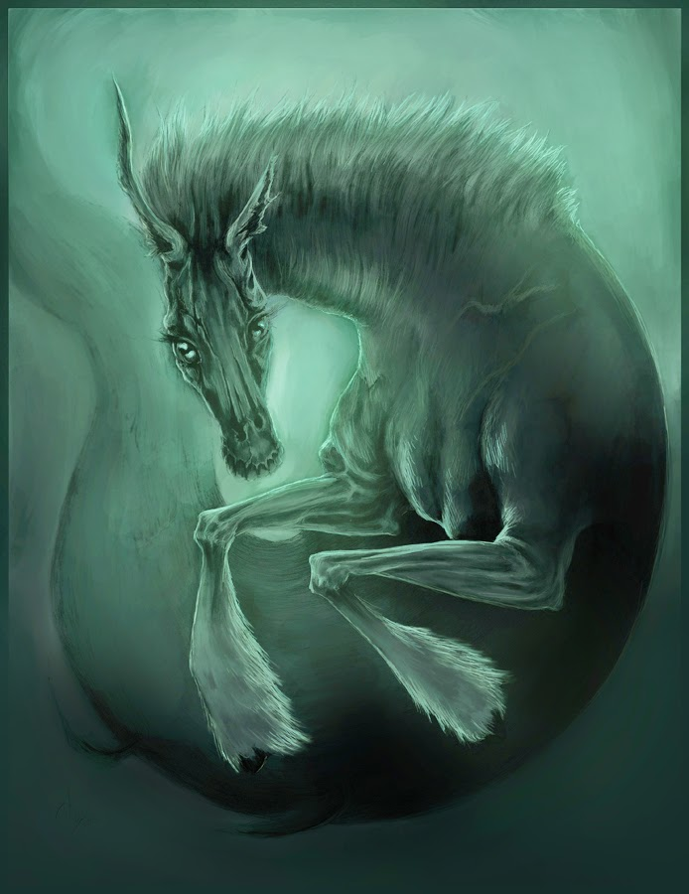
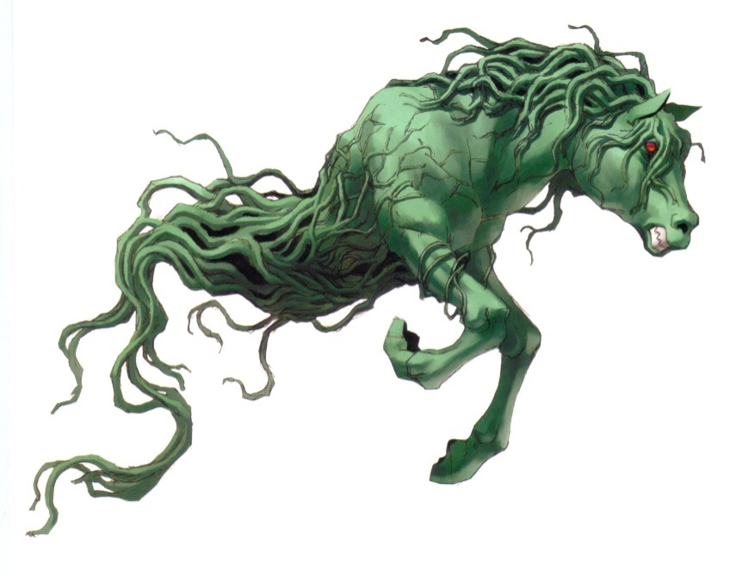

Slide 16
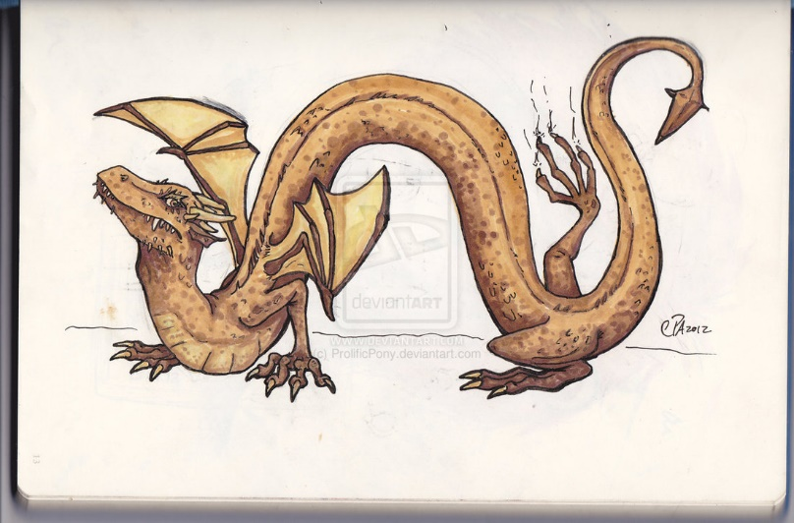

Slide 18
Domovoy is a kind Russian spirit that protects the house. He is a short, about 30 centimeters, old man with a beard. The younger he looks the older he is, as he is believed to be born old and die an infant. Domovoy is wise and has the ability to predict future and cure people and animals. He lives in a secluded corner or a chest or even in a chimney practically in every house. He is the master of the house and doesn’t like the family being lazy or keeping “his” house messy. He can’t stand nervous, feisty, quirky members of the family, and when they are not friendly to each other or don’t treat him with respect he can punish them. To show his disapproval Domovoy slams the door, knocks at the window, disturbs the family at night. You can hear him grumble or whistle. The good thing is that Domovoy can warn the family against the forthcoming misfortunes and troubles, so that the family would be ready to face them. That’s why when the family move to a new place they always ask Domovoy to join them and never leave them.
Read the example and write a description of a legendary creature that’s popular in our country, or one you find interesting. (200 words)

Slide 19
Thank you for your attention!

Slide 20
Resources
http://www.irishcentral.com/culture/craic/the-scariest-monsters-and-demons-from-celtic-myth-67305337-237784881.html?page=2
http://www.mysteriousbritain.co.uk/england/west-sussex/legends/knucker-of-lyminster.html
http://www.thefreedictionary.com
http://www.thesaurus.com

