Slide 1
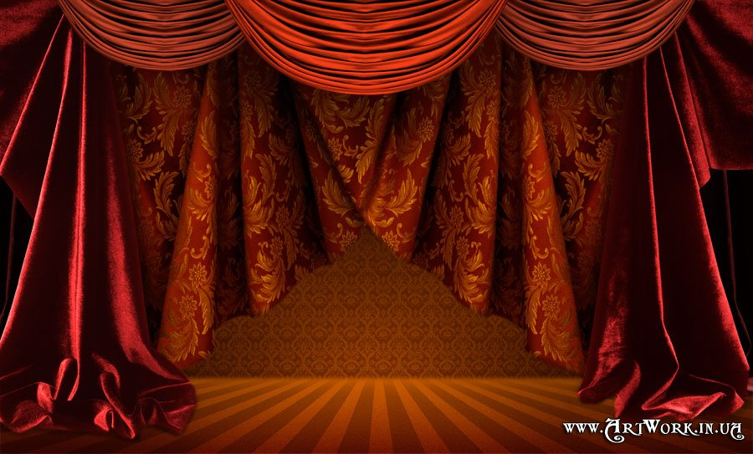
SunRise Theatre Studio
Directed by N.N. Kalashnik
Presents
Beauty IS a Beast
A Children's Play
By D. M. Larson

Slide 2
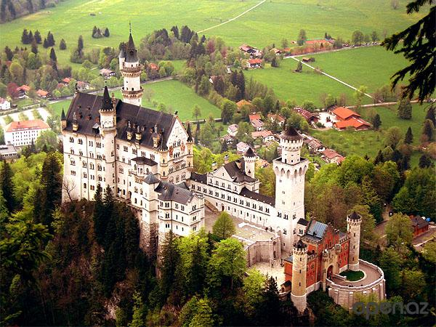

Slide 3
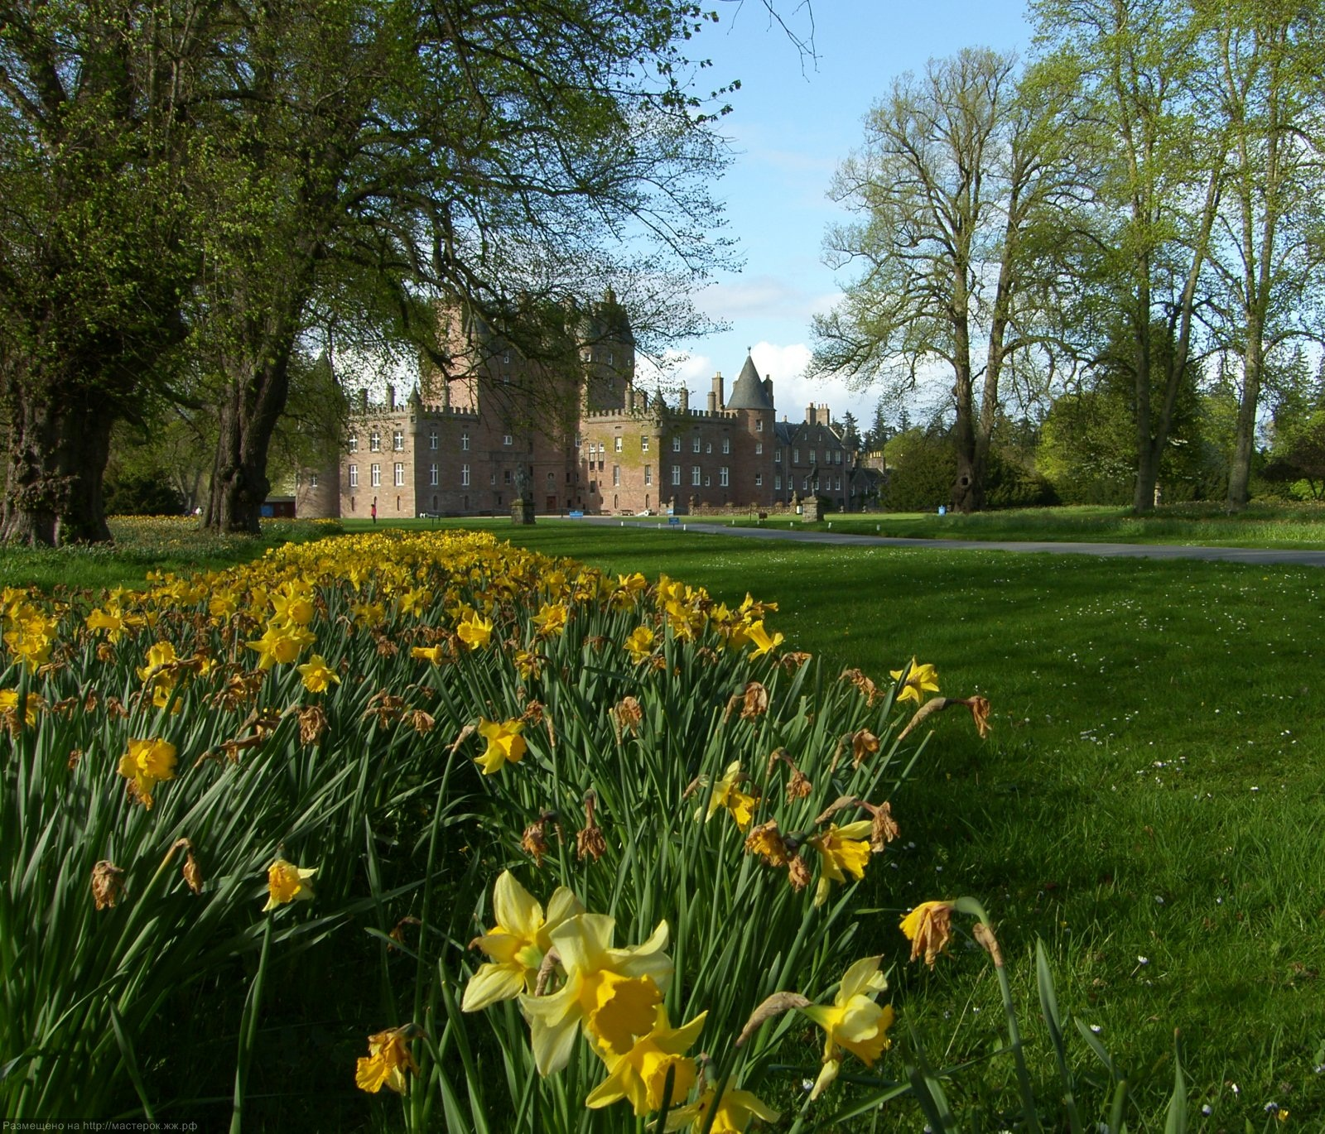

Slide 6
At the Fair

Slide 7
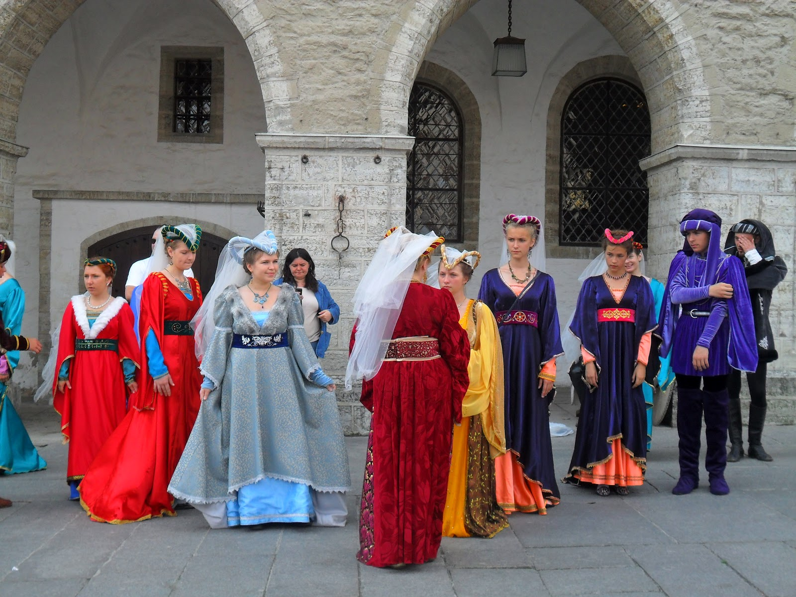

Slide 8
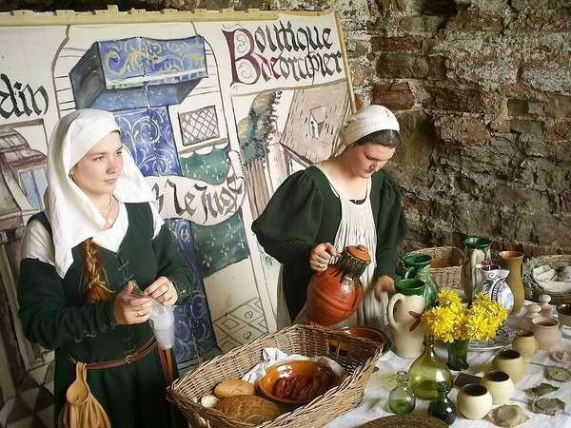

Slide 11
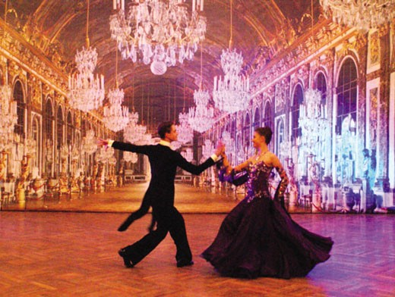

Slide 12
- THE END -
SunRise Theatre Studio
Directed by
N.N. Kalashnik

